Slide 1
MongoDB Relations

Slide 2
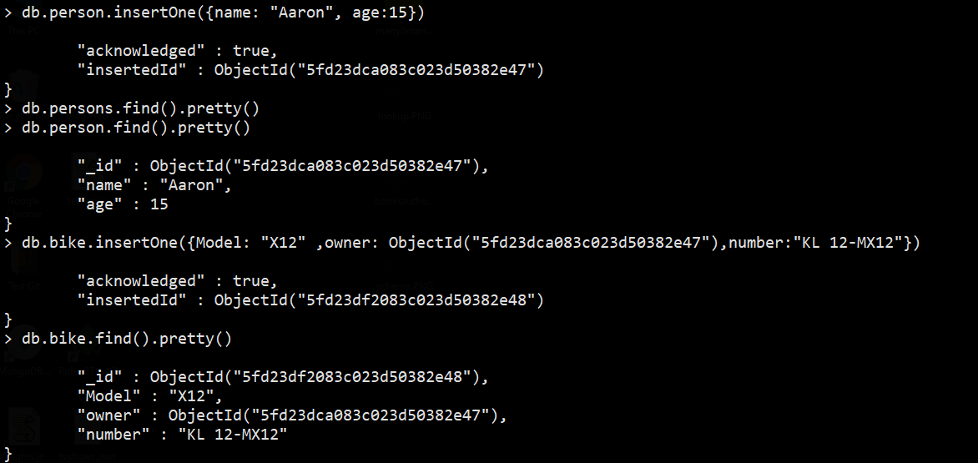
One to One

Slide 3
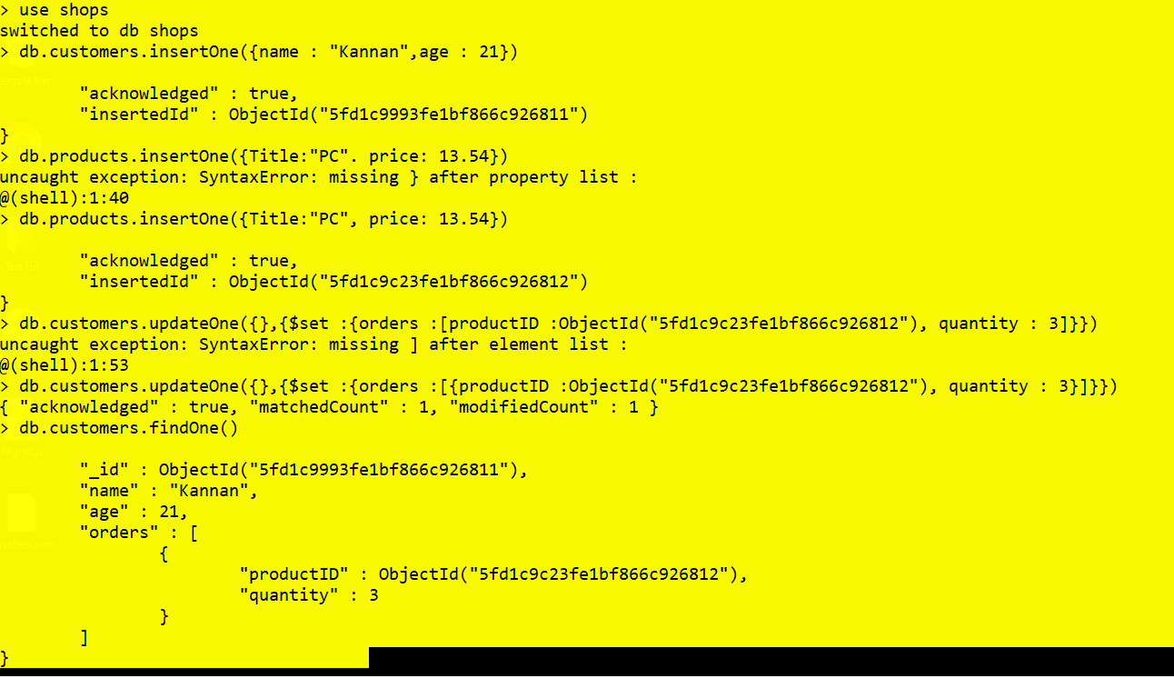
Many to Many

Slide 4
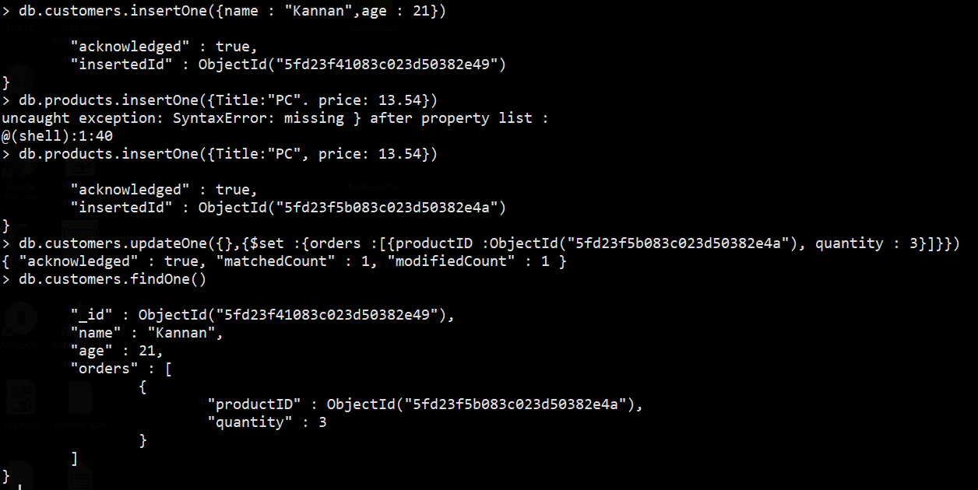
One to Many

Slide 5
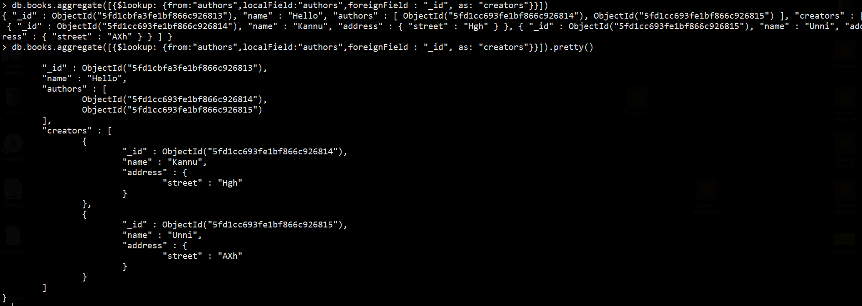
Using lookuP

Slide 6
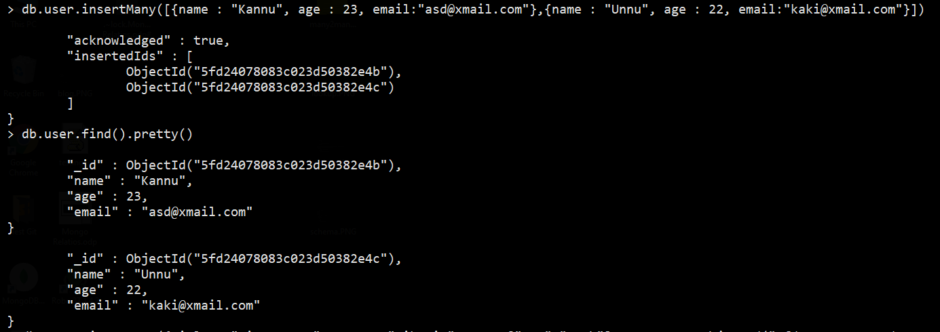
Blog Project

Slide 7

Blog Project

Slide 8
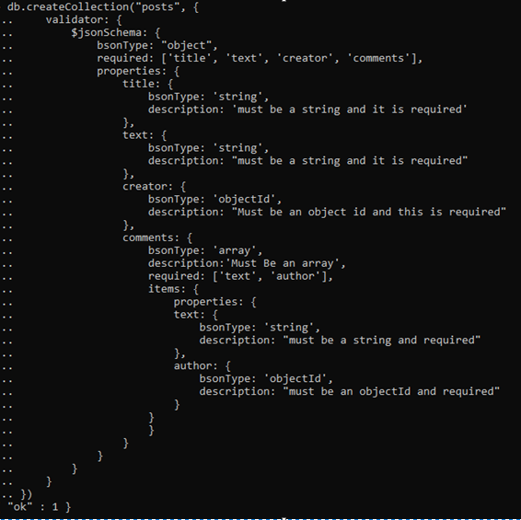
Validator

Slide 9
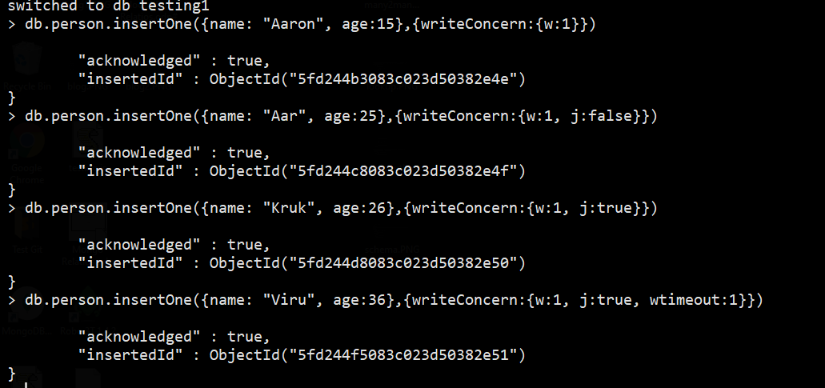
Write Concern

